Slide 1

NLP model
Freddy Roldán Saiqa Mehdi Marina Castillo

Slide 2
Executive summary
Final result: 91,70% accuracy
Model used:
Naive Bayes + CountVectorizer
Tried:
Naive Bayes + TF-IDF / + CountVectorizer
Random Forest + TF-IDF / + CountVectorizer

Slide 3
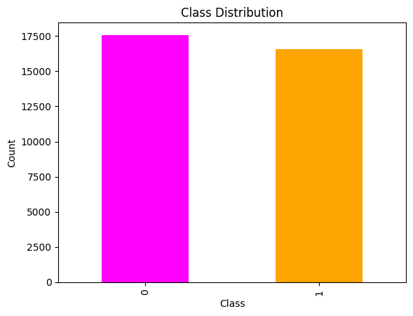
Methods (preprocessing)
Data exploration
Lemmatization
Special Character Removal
StopWords Removal
Tokenization
WordNet

Slide 4
Methods
Naive Bayes and Decision Trees
TF-IDF and CountVectorizer (Faster and Accurate)
Sentiment Analysis (TextBlobs)

Slide 5
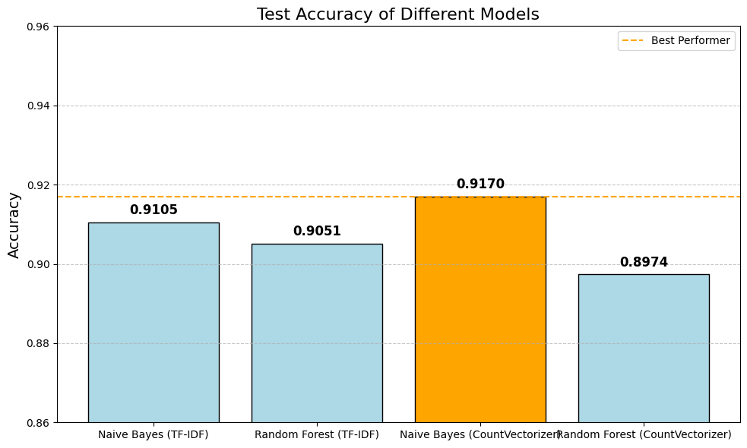
Methods

Slide 6
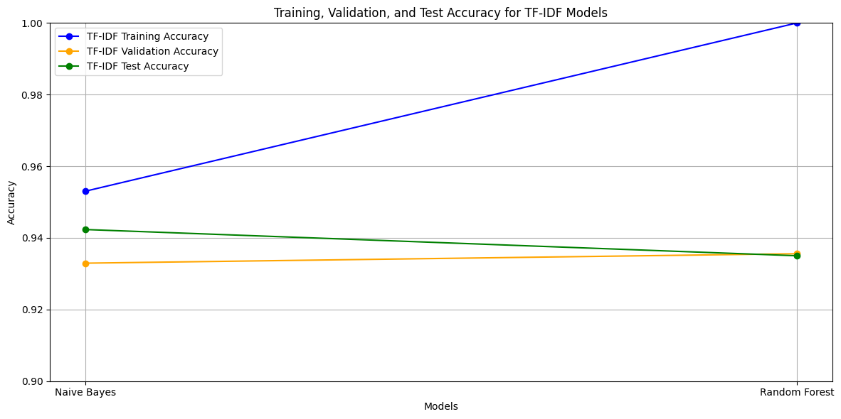
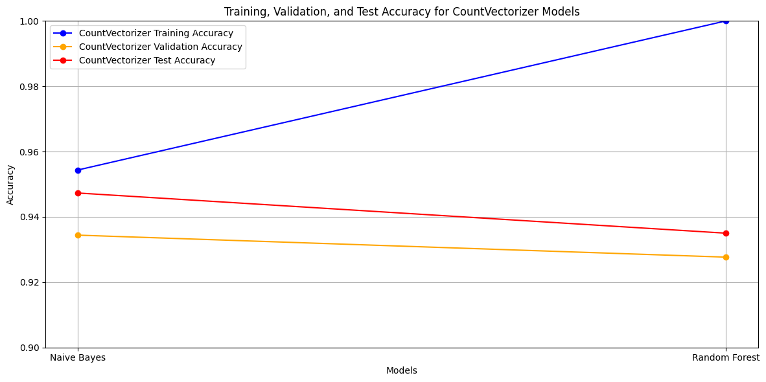
Training, Testing and Validation accuracy
10% for model tuning
10% for evaluation

Slide 7
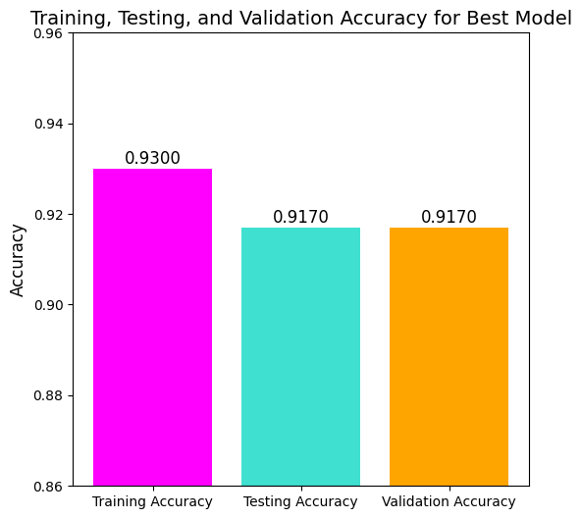
Results of Naive Bayes + CountVectorizer
Cross-Validation Accuracy: 0.9170
Cross-Validation F1 Score: 0.9166
Insights:
Effective Text Classification
Strong Generalization Capability
Consistent Performance Across Cross-Validation Folds
Comparison: Slightly lower than training accuracy (0.9300)
Good generalization
Slightly overfitting

Slide 8
Takeaways
Recap / conclusions
Challenges
Compatibility
Negative Values
Key learnings
Time management
Steps to improve project:
Hyperparameter Tuning
Use Pre Trained Embeddings
More Complex Models

Slide 9
Thank you.
Questions?

